Slide 1

8th Grade Math: Pre-Algebra
Unit 9, Lesson 9 Scale Factors of Dilations Volume 2, pg. 105

Slide 2


Benchmarks
MA.8.GR.2.2
Given a preimage and image generated by a single dilation, identify the scale factor that describes the relationship.
MA.8.GR.2.3
Describe and apply the effect of a single transformation on two-dimensional figures using coordinates and the coordinate plane.
MA.8.GR.2.4
Solve mathematical and real-world problems involving proportional relationships between similar triangles.
volume 2, pg. 105

Slide 3
Integrated Mathematical Thinking and Reasoning Standards
MA.K12.MTR.1.1 Actively participate in effortful learning both individually and collectively.
MA.K12.MTR.2.1 Demonstrate understanding by representing problems in multiple ways.
MA.K12.MTR.4.1 Engage in discussions that reflect on the mathematical thinking of self and others.
MA.K12.MTR.5.1 Use patterns and structure to help understand and connect mathematical concepts.
MA.K12.MTR.7.1 Apply mathematics to real-world contexts.
volume 2, pg. 105

Slide 4

Learning Targets
I can determine the scale factor of a given dilation.
I can solve real-world problems that involve similar triangles.
volume 2, pg. 105

Slide 5

Warm-Up
volume 2, pg. 106

Slide 6
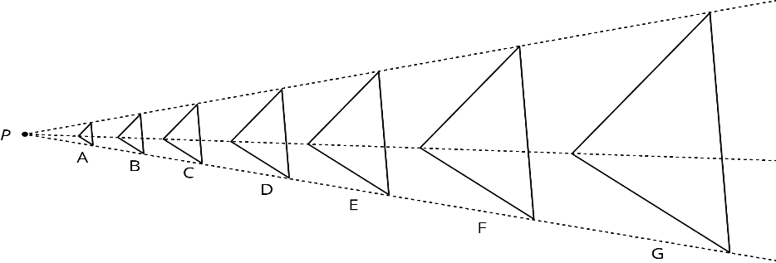
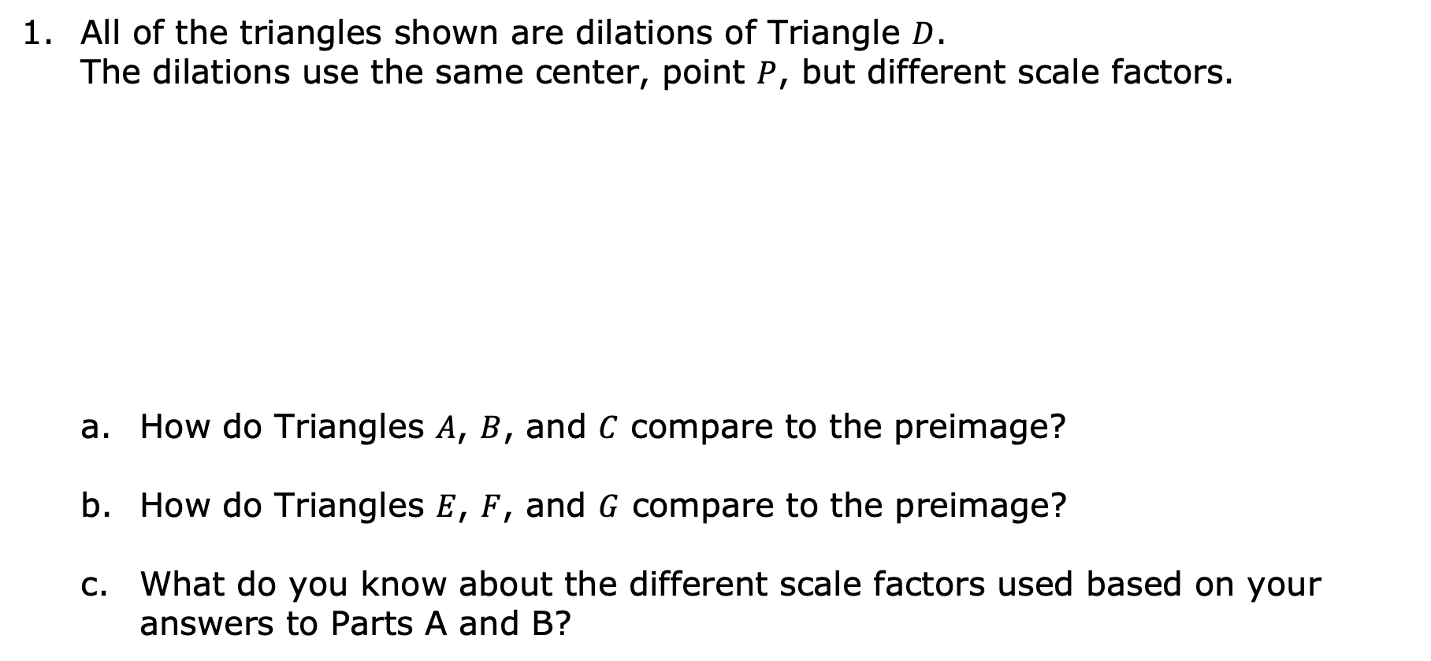
9.9.1 Warm-Up: Bell Work
All of the triangles shown are dilations of Triangle $D$. The dilations use the same center, point $P$, but different scale factors.
How do Triangles $A$, $B$, and $C$ compare to the preimage?
How do Triangles $E$, $F$, and $G$ compare to the preimage?
What do you know about the different scale factors used based on your answers to Parts A and B?
volume 2, pg. 106

Slide 7

Exploration
volume 2, pg. 106

Slide 8

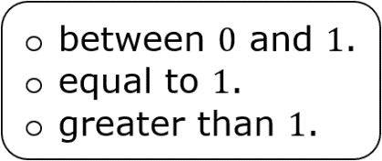

9.9.2 Exploration: Identifying the Scale Factor of Dilations
Work with your partner to complete the following.
Triangle $BHM$ is dilated using point $Y$ as the center, as shown.
Complete the statement.
The scale factor of this dilation is
volume 2, pg. 106

Slide 9

Explain your reasoning.
The measurements, in units, of the side lengths of each triangle have been added to the figure.
Myrical said the scale factor used is $\frac{1}{3}$, while Joshua said it is $3$. Explain who is correct.
volume 2, pg. 107

Slide 10
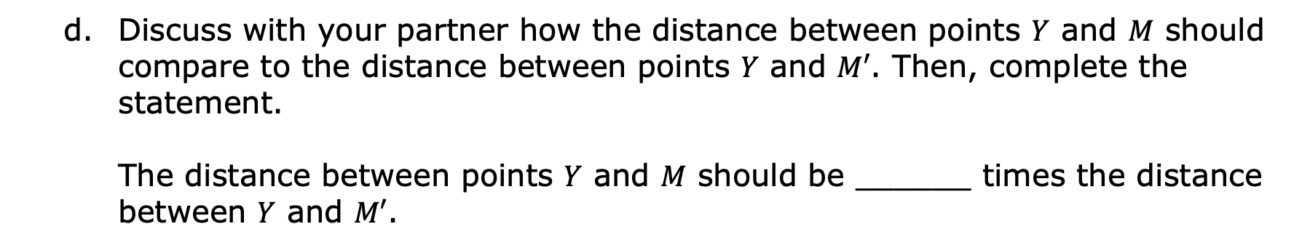
Discuss with your partner how the distance between points $Y$ and $M$ should compare to the distance between points $Y$ and $M′$. Then, complete the statement.
The distance between points $Y$ and $M$ should be ______ times the distance between $Y$ and $M′$.
The distances, in units, between the center of dilation and each vertex on the preimage are shown in purple. The distances, in units, between the center of dilation and each vertex on the image are shown in orange.
Explain whether the information given confirms your answer to Part D.
volume 2, pg. 107

Slide 11


The scale factor of a dilation can be determined using the lengths of the corresponding sides of the preimage or using the distances between the center of dilation and the vertices of the preimage and image.
$Scale factor =$ $\frac{corresponding side length of image}{corresponding side length of preimage}$
$Scale factor= \frac{distance from center to vertex on the image}{distance from center to corresponding preimage vertex}$
volume 2, pg. 107

Slide 12
Quadrilateral $CHNS$ is dilated using the origin as the center, as shown.
volume 2, pg. 108

Slide 13
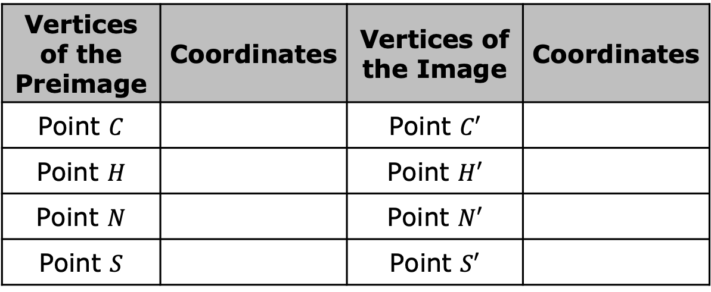
Complete the table.
Describe the relationship between the coordinates of the vertices on the preimage and the corresponding coordinates on the image.
What is the scale factor of the dilation?
Vertices of the Preimage | Coordinates | Vertices of the Image | Coordinates
Point $C$ |  | Point $C′$
Point $H$ |  | Point $H′$
Point $N$ |  | Point $N′$
Point $S$ |  | Point $S′$
volume 2, pg. 108

Slide 14

Collaboration
volume 2, pg. 108

Slide 15

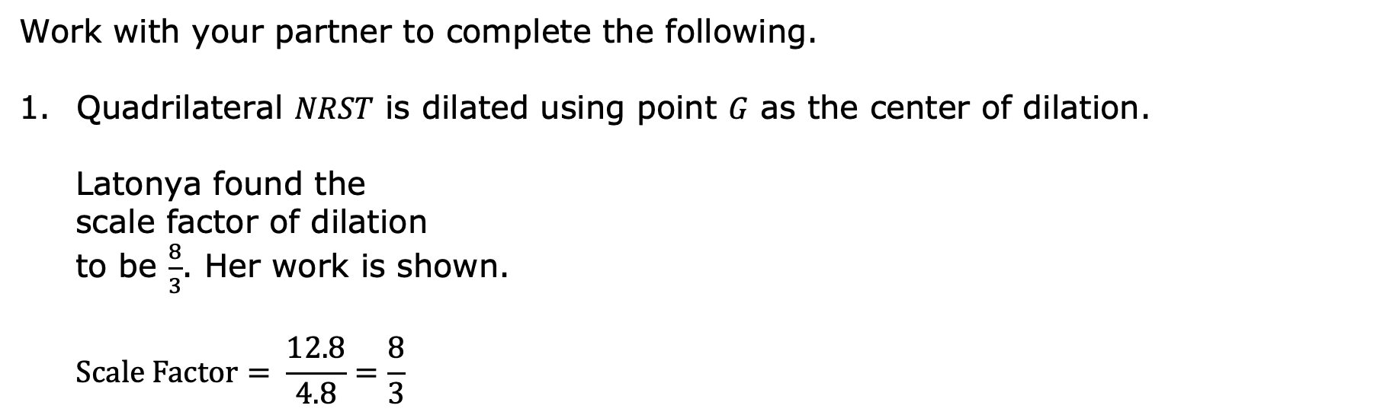
9.9.3 Collaboration: Error Analysis
Work with your partner to complete the following.
Quadrilateral $NRST$ is dilated using point $G$ as the center of dilation.
Latonya found the scale factor of dilation to be $\frac{8}{3}$. Her work is shown.
$$Scale Factor= \frac{12.8}{4.8}=\frac{8}{3}$$
volume 2, pg. 108

Slide 16
Is Latonya correct?
Explain your reasoning.
volume 2, pg. 108

Slide 17
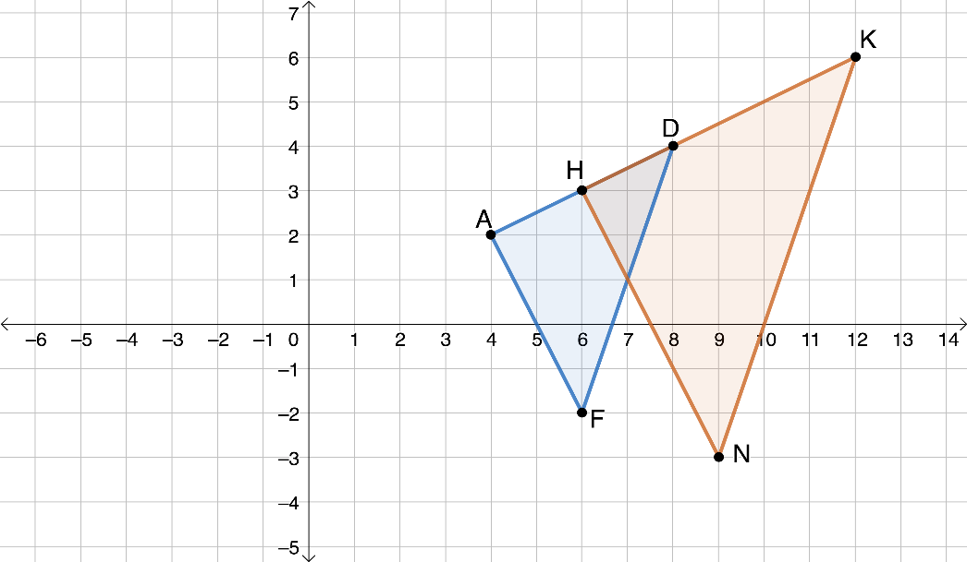

On the coordinate grid, $∆HKN$ is the result of dilating $∆ADF$ using the origin as the center of dilation.
Martell says, ”The scale factor of this dilation is $3$. To find the scale factor, I found the coordinates of point $A$ which were $\left(4, 2\right)$, and then I found the coordinates of point $K$ which were $(12, 6)$. I know the scale factor is $3$ because $4×3=12$ and $2×3=6$.”
volume 2, pg. 109

Slide 18
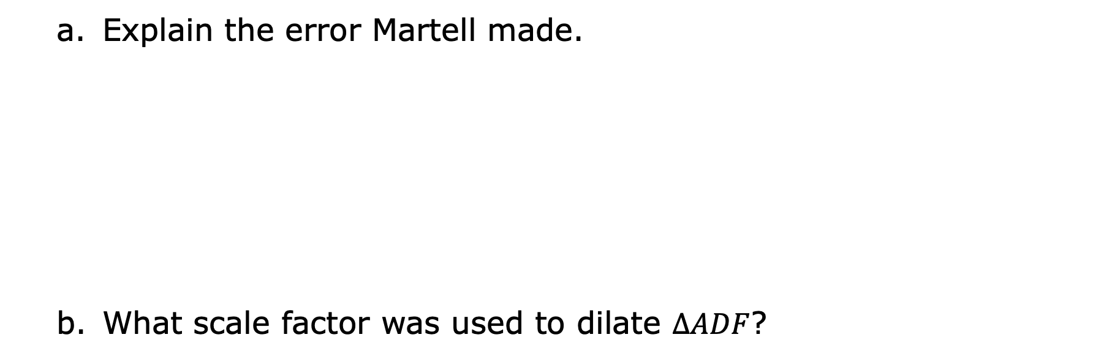
Explain the error Martell made.
What scale factor was used to dilate $∆ADF$?
volume 2, pg. 109

Slide 19

Guided Practice
volume 2, pg. 109

Slide 20

9.9.4 Guided Practice: Dilations in the Real World
Archaeologists have begun using LiDAR (light detection and ranging) technology to map the shape of the ground underneath dense rainforests and jungles. Using this technology, they have discovered numerous ancient cities that have been hidden for thousands of years.
volume 2, pg. 109

Slide 21
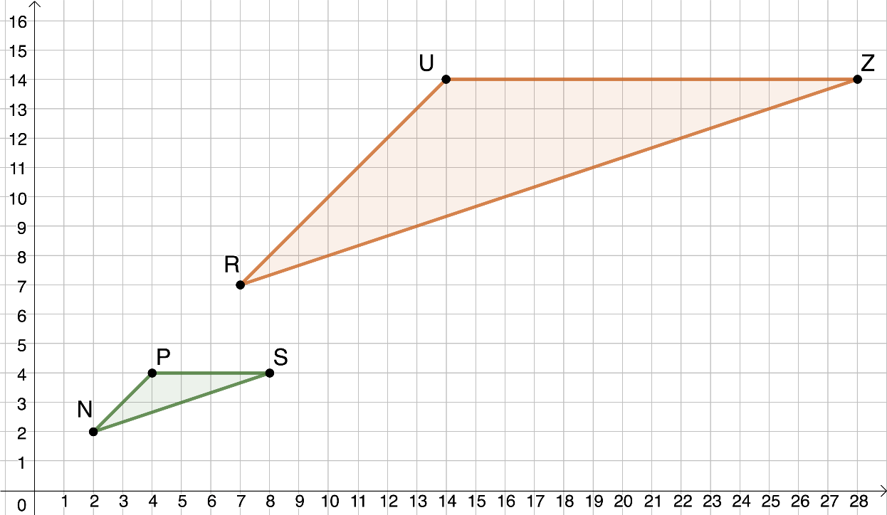
An archaeologist discovered two triangular structures using LiDAR. She overlaid her image on a coordinate grid to analyze the relationship between the structures.
volume 2, pg. 109

Slide 22
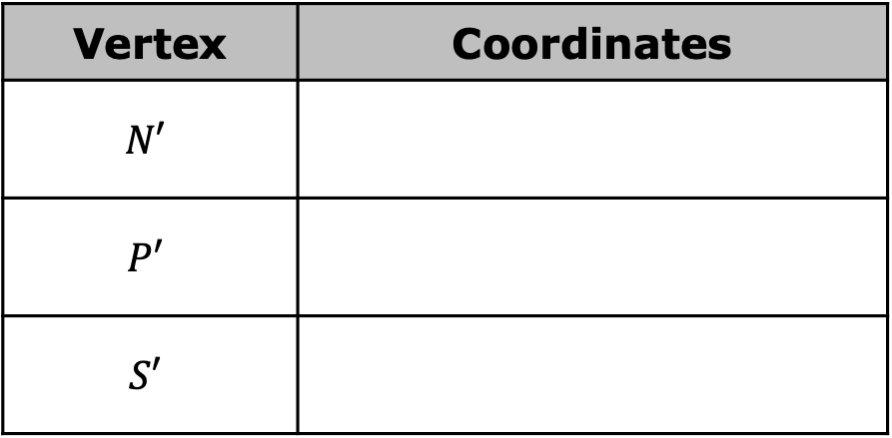
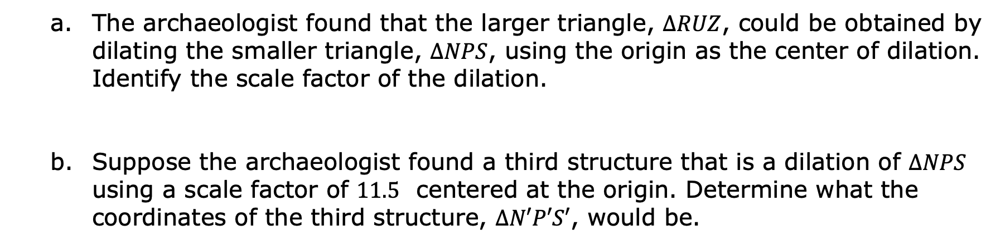
The archaeologist found that the larger triangle, $∆RUZ$, could be obtained by dilating the smaller triangle, $∆NPS$, using the origin as the center of dilation. Identify the scale factor of the dilation.
Suppose the archaeologist found a third structure that is a dilation of $∆NPS$ using a scale factor of $11.5$ centered at the origin. Determine what the coordinates of the third structure, $∆N′P′S′$, would be.
Vertex | Coordinates
$$N′$$
$$P′$$
$$S′$$
volume 2, pg. 110

Slide 23

Wrap-Up
volume 2, pg. 110

Slide 24
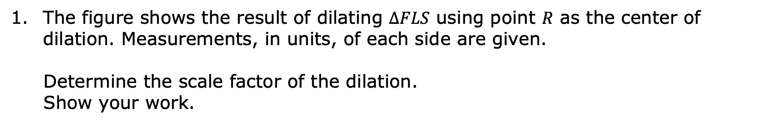
9.9.5 Wrap-Up: Ticket Out the Door
The figure shows the result of dilating $∆FLS$ using point $R$ as the center of dilation. Measurements, in units, of each side are given.
Determine the scale factor of the dilation. Show your work.
volume 2, pg. 110

